Slide 1
Python Sequences
List & Tuple
Session 4a

Slide 2
Objectives
Lists
Tuples

Slide 3
Python - Sequence
The most basic data structure in Python is the sequence. Each element of a sequence is assigned a number - its position or index. The first index is zero, the second index is one, and so forth.
Python has six built-in types of sequences, but the most common ones are lists and tuples, which we would see in this tutorial.
There are certain things you can do with all sequence types. These operations include indexing, slicing, adding, multiplying, and checking for membership. In addition, Python has built-in functions for finding the length of a sequence and for finding its largest and smallest elements.

Slide 4

Python - Lists
Python Lists
  The list is a most versatile datatype available in Python which can be written as a list of comma-separated values (items) between square brackets. Important thing about a list is that items in a list need not be of the same type.
  Similar to string indices, list indices start at 0, and lists can be sliced, concatenated and so on.
  Creating a list is as simple as putting different comma-separated values between square brackets.
  For example −

Slide 5
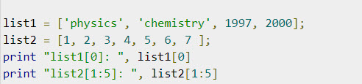

Accessing Values in Lists
To access values in lists, use the square brackets for slicing along with the index or indices to obtain value available at that index. For example −
When the above code is executed, it produces the following result −

Slide 6
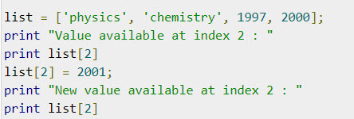

Accessing Values in Lists
Updating Lists
  You can update single or multiple elements of lists by giving the slice on the left-hand side of the assignment operator, and you can add to elements in a list with the append() method. For example −
  Output:

Slide 7
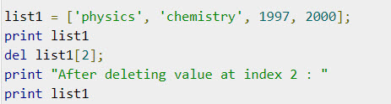

Accessing Values in Lists
Delete List Elements
  To remove a list element, you can use either the del statement if you know exactly which element(s) you are deleting or the remove() method if you do not know. For example
  Output:

Slide 8
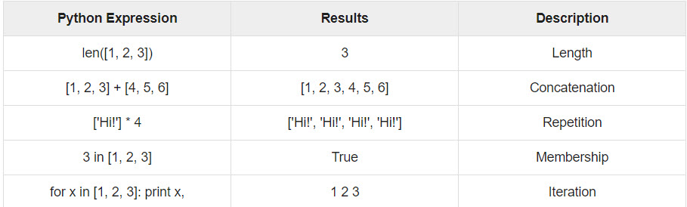
Accessing Values in Lists
Basic List Operations
  Lists respond to the + and * operators much like strings; they mean concatenation and repetition here too, except that the result is a new list, not a string.
  In fact, lists respond to all of the general sequence operations we used on strings in the prior chapter.

Slide 9
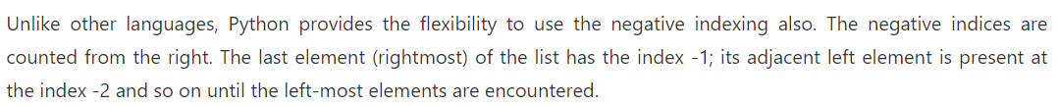
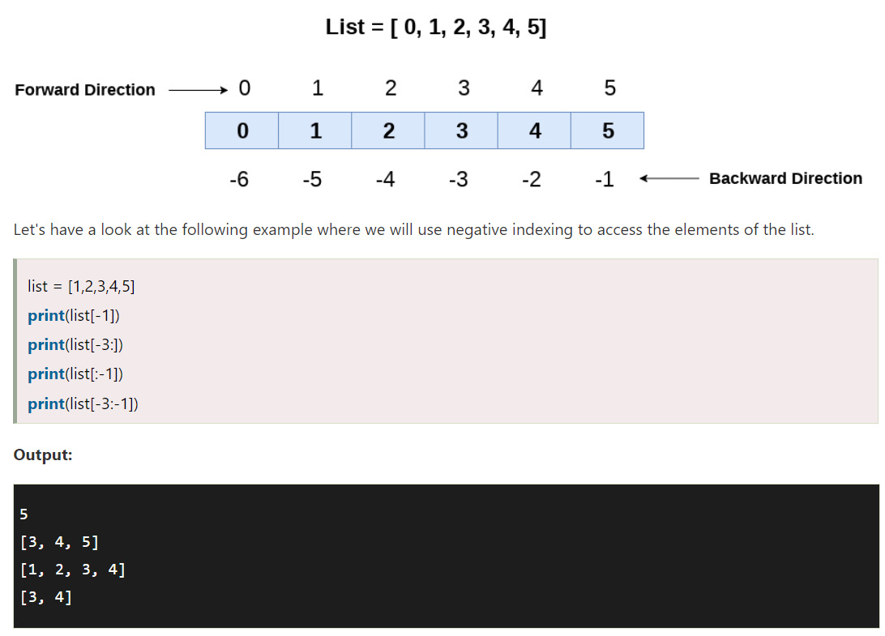
Indexing, Slicing, and Matrixes

Slide 10
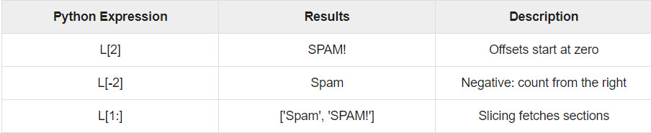
Indexing, Slicing, and Matrixes
Because lists are sequences, indexing and slicing work the same way for lists as they do for strings.
Assuming following input −

Slide 11
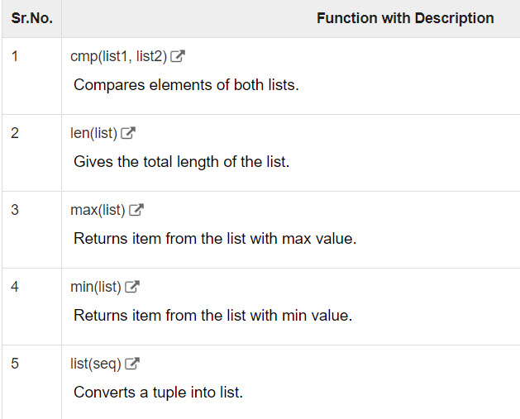
Built-in List Functions & Methods
Python includes the following list functions

Slide 12
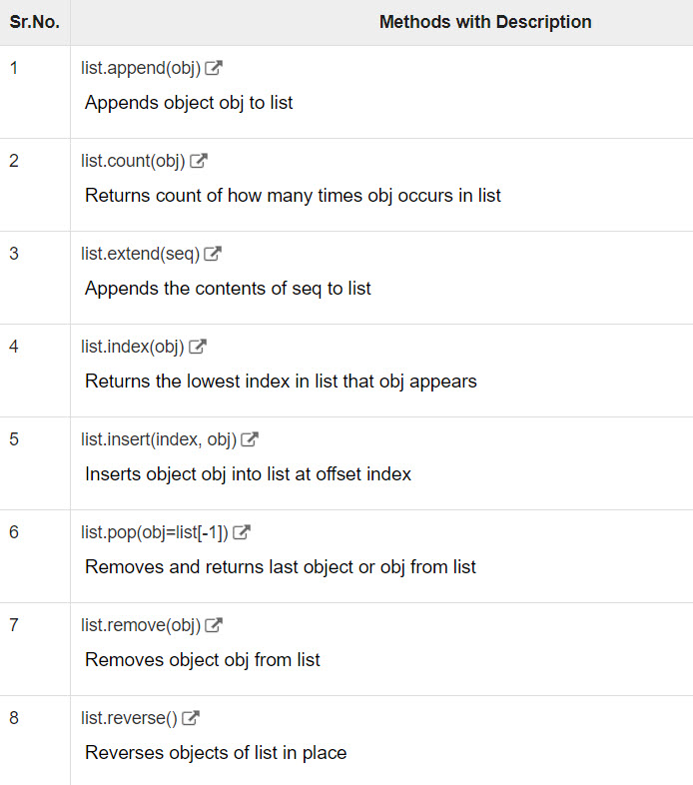
Built-in List Functions & Methods
Python includes following list methods

Slide 13
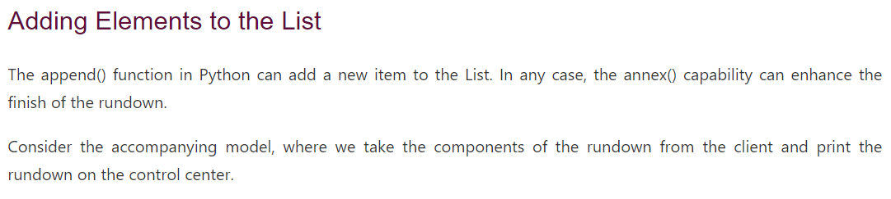
Adding Elements to the List

Slide 14
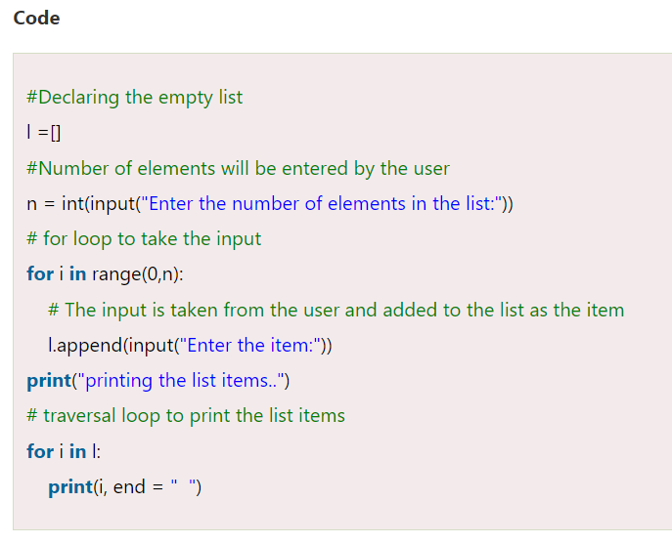
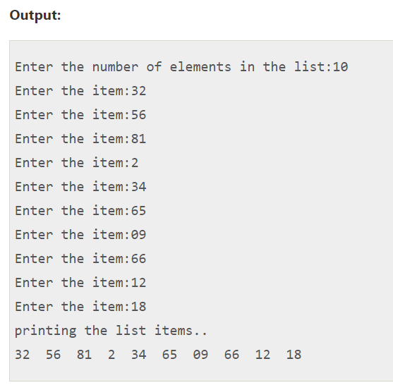
Adding Elements to the List

Slide 15



Python - Tuples
A tuple is a sequence of immutable Python objects. Tuples are sequences, just like lists. The differences between tuples and lists are, the tuples cannot be changed unlike lists and tuples use parentheses, whereas lists use square brackets.
Like string indices, tuple indices start at 0, and they can be sliced, concatenated, and so on.
Creating a tuple is as simple as putting different comma-separated values. Optionally you can put these comma-separated values between parentheses also. For example −
The empty tuple is written as two parentheses containing nothing −
To write a tuple containing a single value you have to include a comma, even though there is only one value

Slide 16
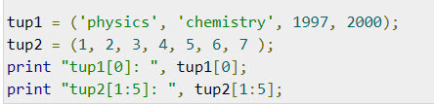

Accessing Values in Tuples
To access values in tuple, use the square brackets for slicing along with the index or indices to obtain value available at that index. For example −
When the above code is executed, it produces the following result −

Slide 17
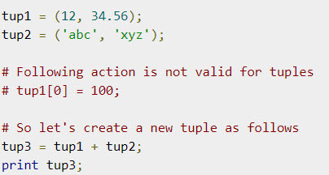

Updating Tuples
Tuples are immutable which means you cannot update or change the values of tuple elements. You are able to take portions of existing tuples to create new tuples as the following example demonstrates −
Output:

Slide 18
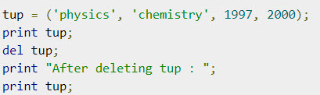
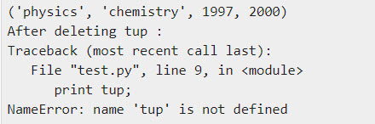
Delete Tuple Elements
Removing individual tuple elements is not possible. There is, of course, nothing wrong with putting together another tuple with the undesired elements discarded.
To explicitly remove an entire tuple, just use the del statement. For example −
Output:

Slide 19
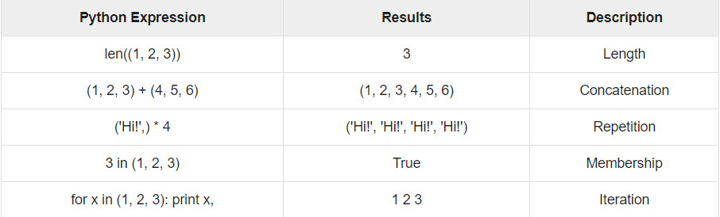
Basic Tuples Operations
Tuples respond to the + and * operators much like strings; they mean concatenation and repetition here too, except that the result is a new tuple, not a string.
In fact, tuples respond to all of the general sequence operations we used on strings in the prior chapter −

Slide 20

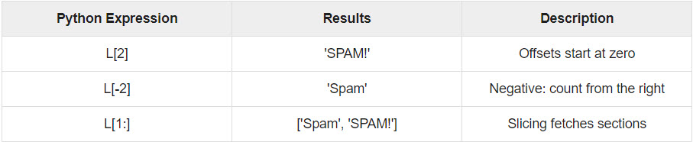
Basic Tuples Operations
Indexing, Slicing, and Matrixes
  Because tuples are sequences, indexing and slicing work the same way for tuples as they do for strings. Assuming following input −

Slide 21
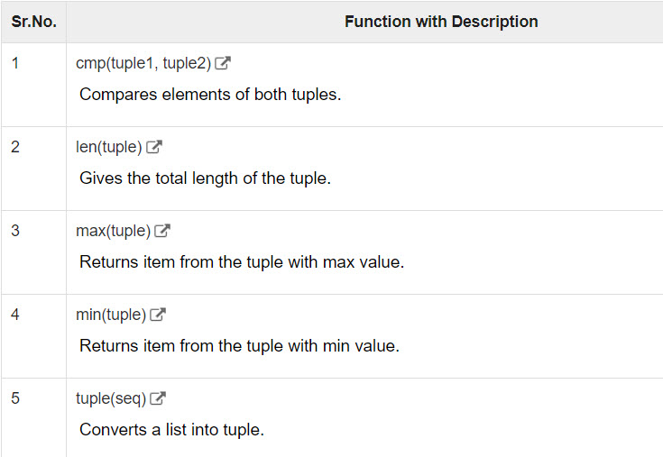
Built-in Tuple Functions
Python includes the following tuple functions −

Slide 22
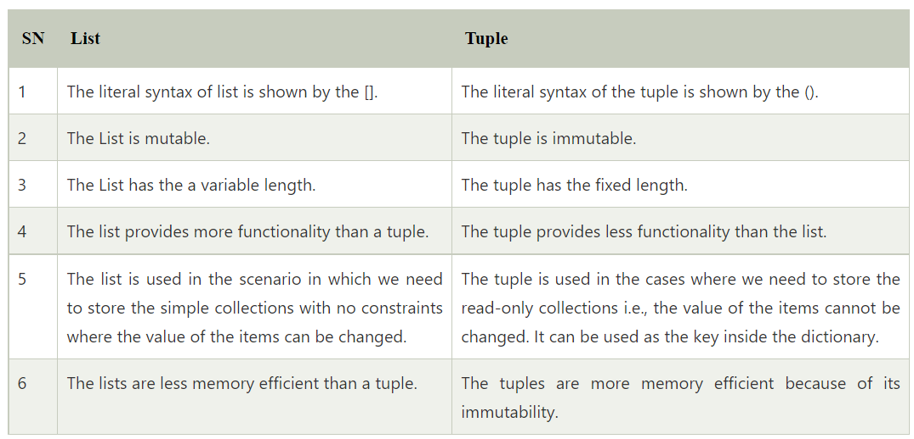
List vs. Tuple

Slide 23
Summary
Lists
Tuples

